Slide 1
API PC-12: The Next Chapter​
Jake Goff – CLS, Application Engineer

Slide 2

AGENDA
What is API?
-What does it do?
-Categories?
-What does it mean for me?
What is PC-12?
-Purpose
-Drivers
-Timeline
The changes coming
What does this mean for the industry?

Slide 3
WHAT IS THE API?

Slide 4

AMERICAN PETROLEUM INSTITUTE
Formed in 1919, following World War I, to
  Unify oil and gas industry
  Promote cooperation between industry and government
  Standardize products and practices
National trade organization representing around 600 corporations in oil and gas industry
Develop engine oil specs, ensuring quality and performance
Formal registration process for light and heavy-duty oil approvals

Slide 5
Who’s making the decisions at API?
EMA – Truck & Engine Manufacturers Association (formerly Engine Manufacturers Association)
  Cummins, Daimler, Volvo/Mack, Paccar, Navistar, John Deere, CAT, Hino, Isuzu
ACC – American Chemistry Council
  Infineum, Lubrizol, Afton, Oronite
Oil Marketers
  Valvoline Global, Shell, Chevron, Mobil
SAE –The Society of Automotive Engineers

Slide 6
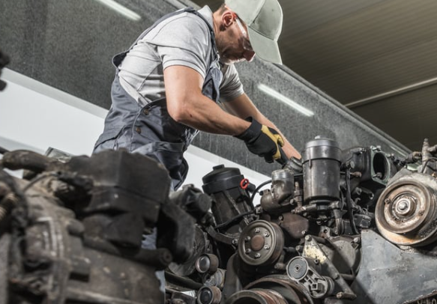
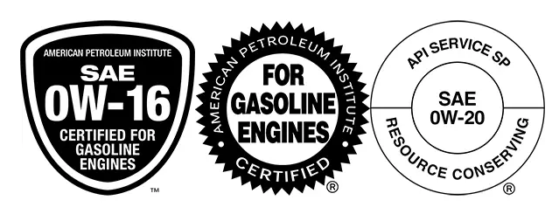

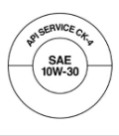
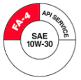
AMERICAN PETROLEUM INSTITUTE
API “S” (Service) Categories are Light Duty
API “C” (Commercial) Categories are Heavy Duty
API “F” (Fuel Economy) Heavy Duty Categories

Slide 7
TIMELINE OF API HEAVY DUTY CATEGORIES
CHANGES DRIVEN BY LEGISLATION FOR FUEL ECONOMY & EMISSIONS
1955
CA, CB/DG, CC/DM
1970: Environmental Protection Agency (EPA) is newly formed; sets national air quality standards.
1970
CD/DS
1985: Legislation to minimize Particulate Matter (PM), NOx, black carbon, sulfur dioxides, and 40 other chemicals
1987
CE, CD-II
1990
2002: Exhaust Gas Recirculation (EGR) introduced, CI-4 to address NOx
2004: CI-4 Plus implemented to address EGR soot increase
2006: CJ-4 launched to suit ultra low sulfur diesel (ULSD)
2007: Diesel Particulate Filter (DPF) introduced
CF, CF-2, CF-4
2000s
CH-4, CI-4, CI-4 Plus, CJ-4
2010: Ammonia Slip Catalyst (ASC) and Selective Catalytic Reduction (SCR) introduced; required for diesel aftertreatment
Dec 2016: CK-4 and FA-4 launched
CK-4 (backward compatible)
FA-4 (not backward compatible)
2010s

Slide 8

GREENHOUSE GAS PHASE PLANS
PHASE 1: Model year 2014-2018
PHASE 2: Model year 2019-2027
2021-2027 for Semi Trucks, Large Pickup, Van, Buses, Work Trucks
17%-25% reduction in emissions from 2010
GHG Phase III, in relation to EV and zero emissions by 2032, is slowed down at this current time.
PHASE 3: Model year 2027-2032
Developed in response EPA and CARB² to the latest GHG³ and fuel mileage regulations being introduced by GHG Phase III
29% reduction from 2021
  Varies according to type – light-heavy, medium heavy, heavy heavy.
  Applies to wider range of vehicles – school buses, delivery trucks, refuse haulers, public utilities, transit, and shuttle buses, day and sleeper tractors.
  Phased in approach
  Not technology agnostic – relying on wide range of technology
  GHG Phase III means 25% of the trucks need to be zero emissions by 2032.
Notes:
25% of HD trucks sold in the US need to be zero emissions by 2032
Important to note that compliance does not trickle down to the fleets themselves, but rather to engine manufacturers.
~ 50% of the trucks on the road are pre 2010.
California advanced clean freight – directed at motor carriers – EPA is going to have to get a waiver
CARB

Slide 9

HOW DOES API IMPACT CUSTOMERS?
Protects your investment
  Engines/Equipment are biggest asset
  First level of proof of performance recognized by the industry.
Compliant with OEM and warranties
  Most manufactures require at least API approved oils
  Use of non approved oils could mean voiding warranty or failures if the oil does not provide the necessary level of protection

Slide 10
HOW DOES API IMPACT CUSTOMERS?
Improves Performance
  More efficient fluids with each new category (fuel efficient categories added)
  Lower emissions, longer aftertreatment life
  Higher wear and oxidation performance
Future Proof
  API follows the EPA and GHG (greenhouse gas) Rules
  Ensures your fleet meets these requirements from an oil perspective as well
Simplifies Decision Making
  Using API designations like API “donut”
  Helps weed out the oils that may not have the level of performance required
Overall: It raises the floor

Slide 11
HOW DOES API IMPACT FLEETS?
Improves Performance
  Greater efficiency
  Lower emissions → longer aftertreatment life
  Higher wear and oxidation performance
Allows OEMs to set an engine oil standard
  API follows the EPA and GHG (greenhouse gas) Rules
  Ensures the engine oil meets the OEM’s performance standards
Simplifies Decision Making
  Using API designations like API “donut”
  Helps weed out the oils that may not have the level of performance required
Overall: It raises the floor

Slide 12
WHAT IS PC-12?

Slide 13

Proposal Category-12
Will become the newest category of heavy-duty engine oil for 2027 emission compliant engines.
Proposed Category 12 (Prename before launch) – Two subcategories
  CL-4 and FB-4 are proposed new names for launch, to replace CK-4 and FA-4
Driven by new EPA and CARB regulations starting in 2027
  First License with API is Jan. 2027
Notes:
Looking Ahead:
Regulations might change as far as how much will have to be zero emissions by 2032 as Phase 3 originally planned due to potential changes in legislation, but the industry is moving forward with these new oils regardless to address lower emission targets.
Diesel Engine Oil Advisory Panel (DEOAP) established a New Category Evaluation Team (NCET) NCDT New Category Development Team
Hardware for testing is harder to get indicating it’s time for new tests.
• EPA 2027 rule will push toward near-zero NOx & longer system life.
• ZEV push: Electric trucks (e.g., Tesla Semi), hydrogen fuel cells, and hybridization will expand.
• CARB, EPA, and GHG rules will all tighten further, likely requiring total system redesigns.
• Some engine platforms may discontinue diesel entirely for urban duty cycles.

Slide 14
PC-12 vs what we have today
Viscometric
SAPS
Engine Stand Test

Slide 15














CK-4 AND FA-4 BOTH CONTINUE FORWARD IN PC-12
PC-12A
“C”
PC-12B
“F”
New API oils are being introduced in 2027 to align with new GHG Phase III.
ENHANCED DURABILITY
XW-30 and heavier
SAE GRADES
XW-30 and XW-20
The category will continue to be split into high and low HTHS or High Temperature High Shear subcategories.
HTHS:
2.9-3.2 cP XW-30 Oils,
≥ 2.6 cP for XW-20’s
HTHS: >3.5 cP
VISCOSITY
GOOD
FUEL ECONOMY
BETTER/BEST
BACKWARDS SERVICABLE
APPLICATIONS

Slide 16
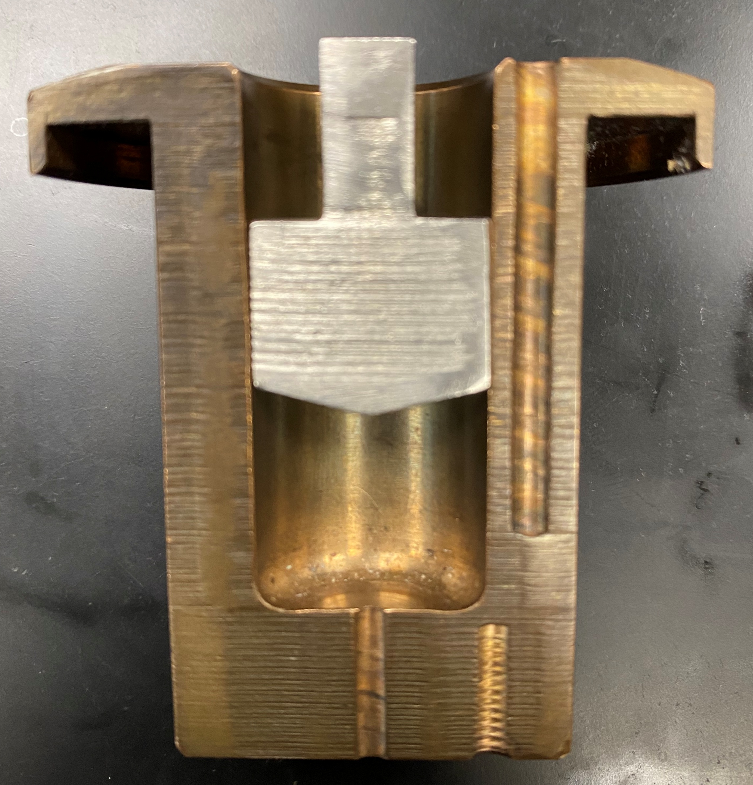
HTHS – High Temperature High Shear
Still measuring a fluids resistance to flow but adding a factor called shear
Shear – Stress that occurs when fluid layers are forced to slide past one another at high speed and pressure
Designed to mimic engine conditions
Notes:
Looking Ahead:
Regulations might change as far as how much will have to be zero emissions by 2032 as Phase 3 originally planned due to potential changes in legislation, but the industry is moving forward with these new oils regardless to address lower emission targets.
Diesel Engine Oil Advisory Panel (DEOAP) established a New Category Evaluation Team (NCET) NCDT New Category Development Team
Hardware for testing is harder to get indicating it’s time for new tests.
• EPA 2027 rule will push toward near-zero NOx & longer system life.
• ZEV push: Electric trucks (e.g., Tesla Semi), hydrogen fuel cells, and hybridization will expand.
• CARB, EPA, and GHG rules will all tighten further, likely requiring total system redesigns.
• Some engine platforms may discontinue diesel entirely for urban duty cycles.

Slide 17
DIFFERENCE BETWEEN PC-11 AND PC-12
Specification | Current CK-4/FA-4 | PC-12 C/F Category
Phosphorous, % max | 0.12 | 0.08
Sulfur, % max | 0.4 | 0.3
Ash, % max | 1 | 0.9
Less metals translates to better aftertreatment efficiency
  Less ZDDP improves the SCR’s NOx conversion efficiency to nitrogen and water
  Less Sulfur simply means less Sox
  Less detergent (ca & mg) increases filter capacity which means less regens

Slide 18
SAPS – Sulfated Ash, Phosphorus, and Sulfur
Sulfated Ash
  Consist primarily of detergents and anti-wear additives
  Also helps neutralize acids
Phosphorus
  A key component of ZDDP (anti-wear)
Sulfur
  Enhances anti-wear and oxidation performance
Notes:
Looking Ahead:
Regulations might change as far as how much will have to be zero emissions by 2032 as Phase 3 originally planned due to potential changes in legislation, but the industry is moving forward with these new oils regardless to address lower emission targets.
Diesel Engine Oil Advisory Panel (DEOAP) established a New Category Evaluation Team (NCET) NCDT New Category Development Team
Hardware for testing is harder to get indicating it’s time for new tests.
• EPA 2027 rule will push toward near-zero NOx & longer system life.
• ZEV push: Electric trucks (e.g., Tesla Semi), hydrogen fuel cells, and hybridization will expand.
• CARB, EPA, and GHG rules will all tighten further, likely requiring total system redesigns.
• Some engine platforms may discontinue diesel entirely for urban duty cycles.

Slide 19
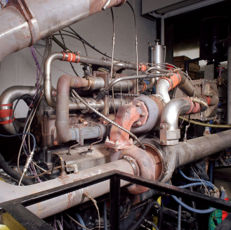
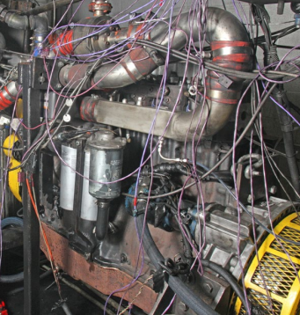
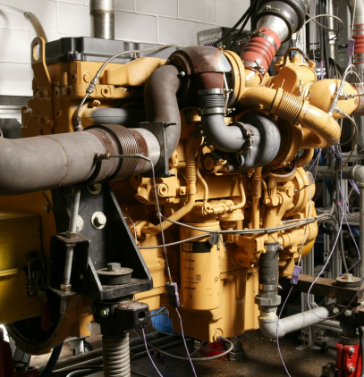
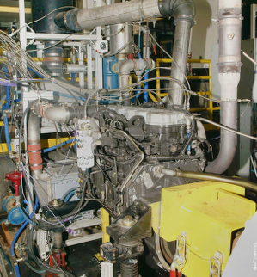
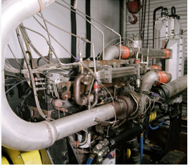
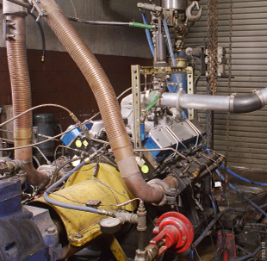
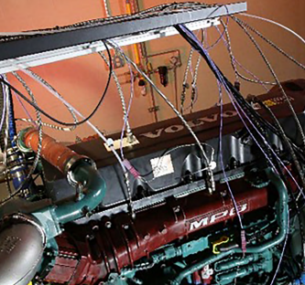
Engine Tests: What’s Changing
Mack T-11
DD13 Scuffing Test will be added – measures piston/liner wear, already in Detroit’s approval
Mack T-11 test is to be replaced with ISB Soot due to lack of parts available
CAT 1N eliminated due to redundancy with CAT C13 test
Mack T-12 eliminated because of correlations with Cummins ISB cam wear test
Tighter limits for oxidation performance (T-13 Volvo/Mack VDS 4.5 limits)
Total number of test reduced from 8 to 7 for PC-12
Soot Thickening
Mack T-12
Wear
CAT C13
Cummins ISB
Cummins ISM
RFWT
Volvo T-13
Piston Deposits & Wear
Oxidation & Cam Wear
Piston Deposits
Oil Aeration
Oxidation Stability
Notes:
CAT 1N –
CAT C13 – Piston Deposits and Oil Consumption
CAT COAT (Caterpillar oil aeration test) – High Idle Aeration
Cummins ISB – Valve Train Wear w/ soot
Cummins ISM – Valve Train wear and Deposits
Roller Follower Wear Test (RFWT) – Wear (low/moderate engine speeds)
Mack T-11 – Viscosity Increase and Soot Loading Performance
Sooted MRV from Test
Mack T-12 –Wear Test w/ EGR and ULSD
Volvo T-13 - Oxidation
~~~~~~~~~~~~~~~~~~~~~~~~~~~~~~~~~~~~~~~~~~~~~~~~~~~~~
CAT 1N –
CAT C13 – Piston Deposits and Oil Consumption
CAT COAT (Caterpillar oil aeration test) – High Idle Aeration
Cummins ISB – Valve Train Wear w/ soot
Cummins ISM – Valve Train wear and Deposits
Roller Follower Wear Test (RFWT) – Wear (low/moderate engine speeds)
Mack T-11 – Viscosity Increase and Soot Loading Performance
Sooted MRV from Test
Mack T-12 –Wear Test w/ EGR and ULSD
Volvo T-13 - Oxidation

Slide 20
Engine Test
DD13 Scuffing Test will be added – measures piston/liner wear, already in Detroit’s approval
Mack T-11 test is to be replaced with ISB Soot due to lack of parts available
CAT 1N eliminated due to redundancy with CAT C13 test
Mack T-12 eliminated because of correlations with Cummins ISB cam wear test
Tighter limits for oxidation performance (T-13 Volvo/Mack VDS 4.5 limits)
Total number of test reduced from 8 to 7 for PC-12

Slide 21
History of FA-4 by OEM
Cummins – 2017
  Models X15 and X12
  In 2024 they swapped FA-4 as the recommended product for X15’s
Detroit Diesel – 2017
  Models DD13, DD15, and DD16
  Back as far as 2010
Volo/Mack – 2021
  Models D11, D13, and MP8
Paccar – Still on CK-4
Navistar – 2017-2020
  Model A26
  2021 and up were placed back on CK-4
*CAT and John Deere are still not permitting FA-4

Slide 22
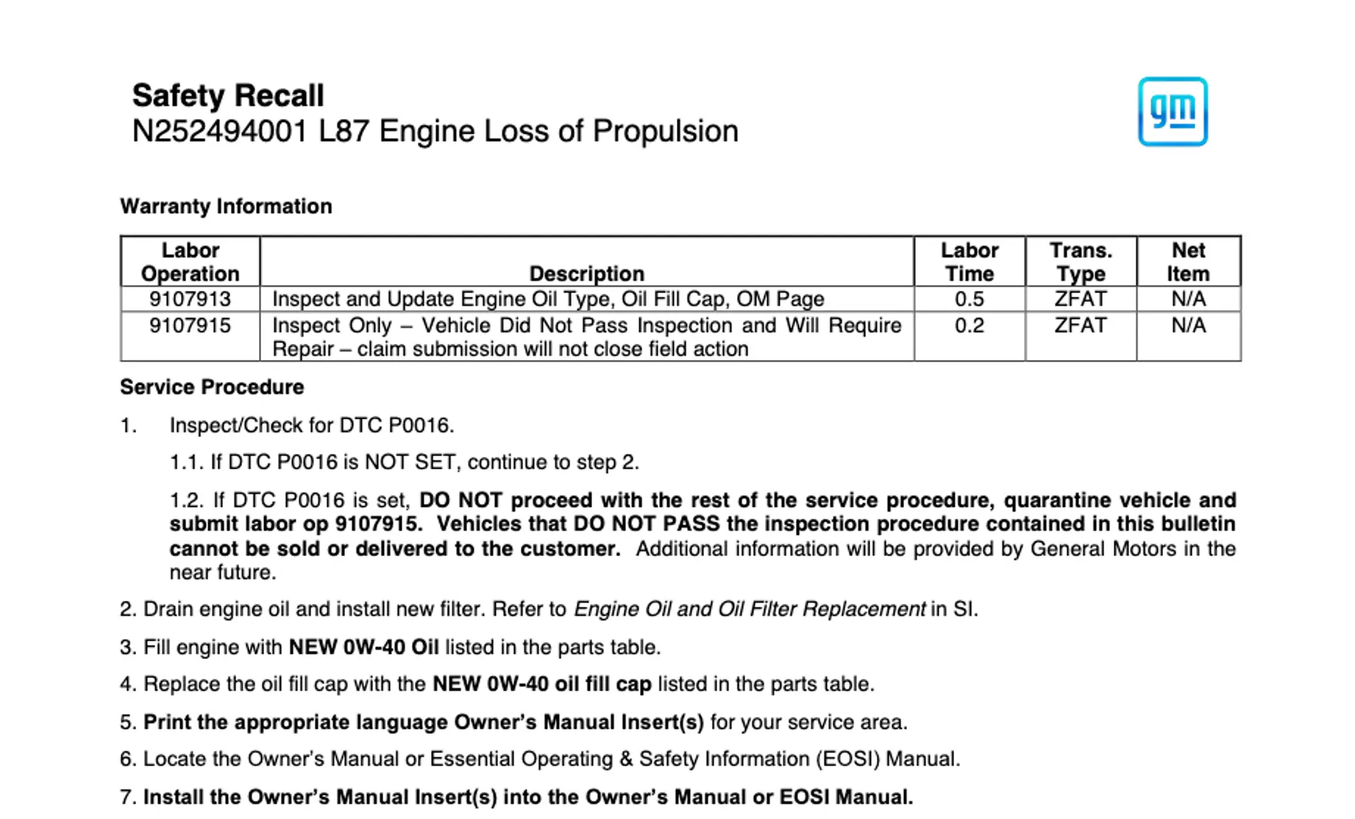
GM’s quick fix
Notes:
Looking Ahead:
Regulations might change as far as how much will have to be zero emissions by 2032 as Phase 3 originally planned due to potential changes in legislation, but the industry is moving forward with these new oils regardless to address lower emission targets.
Diesel Engine Oil Advisory Panel (DEOAP) established a New Category Evaluation Team (NCET) NCDT New Category Development Team
Hardware for testing is harder to get indicating it’s time for new tests.
• EPA 2027 rule will push toward near-zero NOx & longer system life.
• ZEV push: Electric trucks (e.g., Tesla Semi), hydrogen fuel cells, and hybridization will expand.
• CARB, EPA, and GHG rules will all tighten further, likely requiring total system redesigns.
• Some engine platforms may discontinue diesel entirely for urban duty cycles.

Slide 23
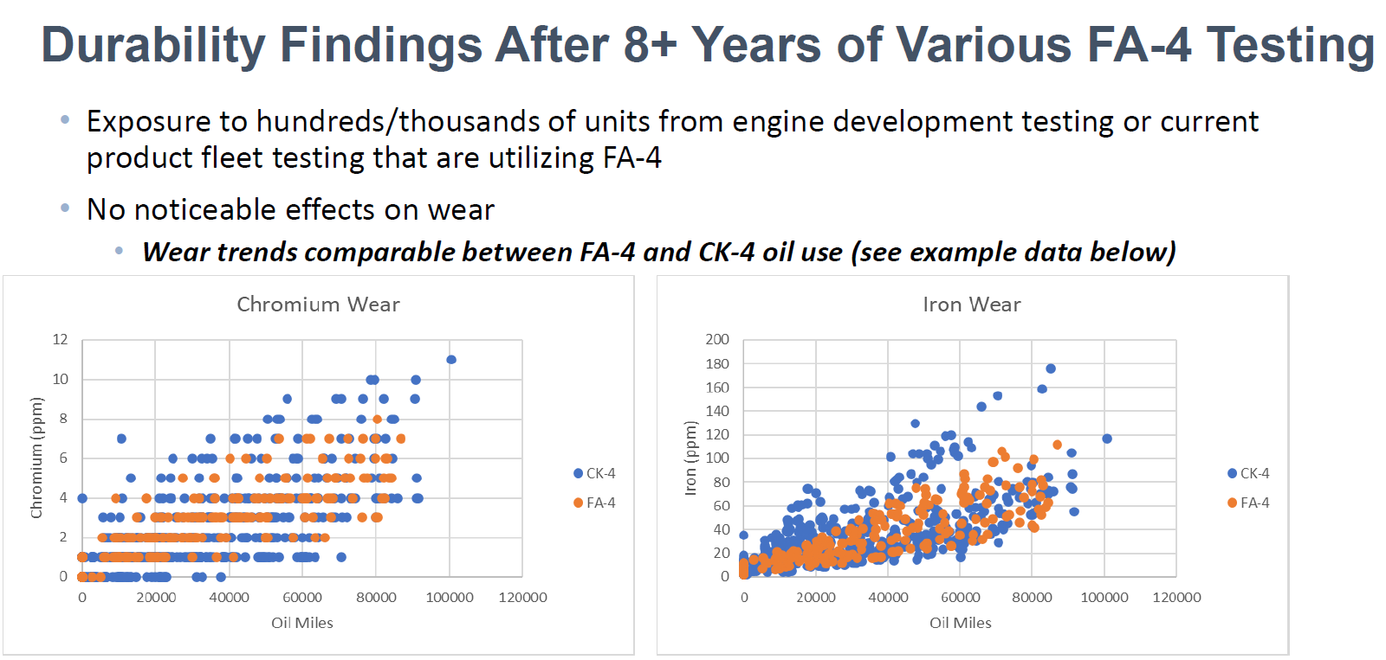
Ryan Denton – “Where FA-4 is permitted.. no significant risks exist in normal operation”

Slide 24
Some of the last things worth mentioning
FB-4 technically will not be backwards to FA-4 due to soot handling
  - OEMs are likely going to allow engines on FA-4 to use FB-4
EPA is mandating NOx to be below 0.035 g/hp-hr. The limit has been 0.2 since 2010.
  - For model year 2027
Many OEMs might not initially permit the new XW-20 grade for FB-4

Slide 25
HOW DOES PC-12 IMPACT CUSTOMERS?
Storage Tanks
  Fleets can’t entirely move to FB-4 until the entire fleet is able to use FB-4
All engines are still permitted to use CK-4
  This will likely stay true with CL-4
Better aftertreatment life
  Less metals
Stronger Anti-Wear Performance
  Not all ZDDP is created equal
  More Molybdeum and Boron will be used
  Use of better base oils
More Oxidatively Stable

Slide 26
THANK YOU FOR YOUR TIME!
QUESTIONS?

